Slide 1
Billiards Simulation
P76044025 黃粲富
P76044059 張傑程
P76044449 林意瑄
P76044481 吳邦宇

Slide 2
Outline
Introduction
Physical System
Jump shot
Application-2
Conclusion

Slide 3
Outline
Introduction
Physical System
Application - Jump shot
Application-2
Conclusion

Slide 4
Introduction
Goal
Create a pool ball games simulator
Using this simulator to do some application, such as searching best angle / force

Slide 5
Introduction
Environment
Unity Engine
C# programming language

Slide 6
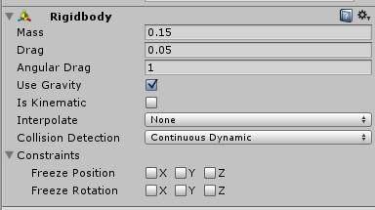
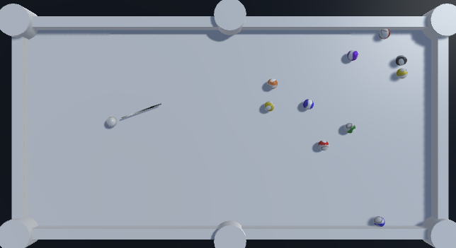
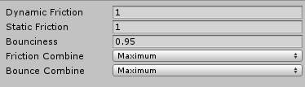
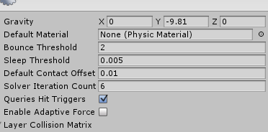
Introduction
Unity built-in physical system

Slide 7

Introduction
Simulator based on Unity physical system

Slide 8
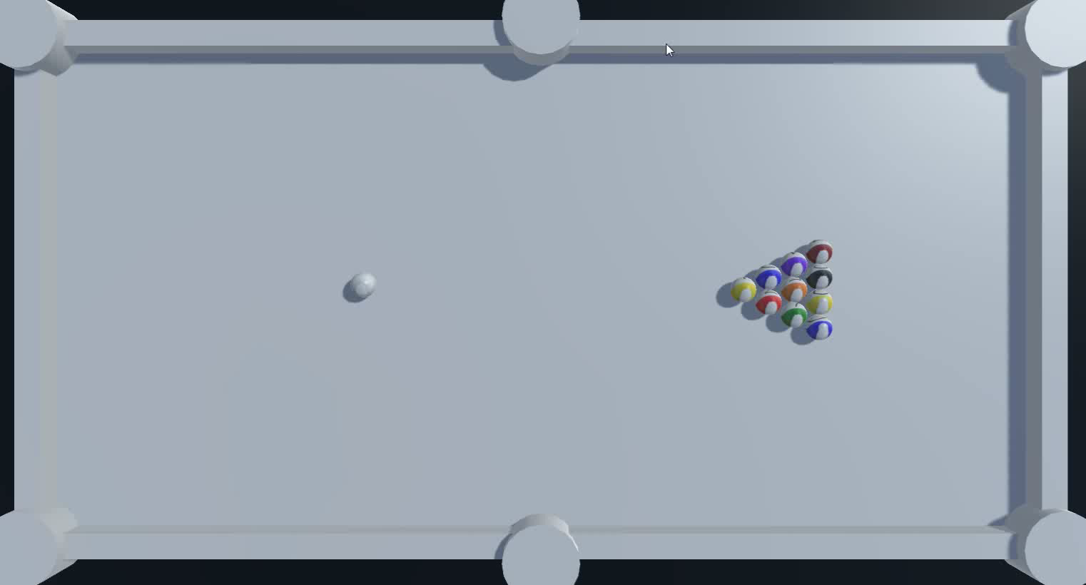
Introduction
Simulator based on our physical system

Slide 9
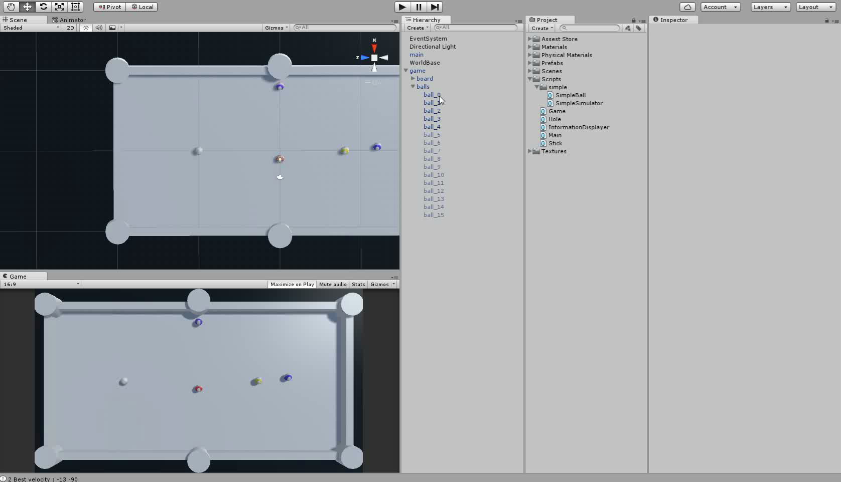
Introduction
Application

Slide 10
Outline
Introduction
Physical System
Application-1
Application-2
Conclusion

Slide 11

Physical System
$v_{1}^{′}$ = $v_{1}^{ }+\frac{m_{1}^{ }({v_{2}−v}_{1})}{m_{1}^{ }}$
${mv}_{1}^{ }$+ ${mv}_{2}^{ }$ = ${mv}_{1}^{′}$ + ${mv}_{2}^{′}$
$v^{′}={0.8v}^{ }$(every second)
rotation -> ($∆z, 0, ∆x$)/radius

Slide 12

Physical System
Example :
$v_{a}^{ }$=(3, 0, 0) $v_{b}^{ }$=(2, 0, 0)
collide(a,b) ->
$v_{a}^{′}$=(3 + (2-3), 0, 0) = (2, 0, 0)
$v_{b}^{′}$=(3, 0, 0)

Slide 13
Outline
Introduction
Physical System
Application - Jump shot
Application-2
Conclusion

Slide 14
Application - Jump shot
Optimized flow
Find optimized solution iteratively
Simulate the condition with user-defined parameters endTime & deltaTime
Notes:
To find the optimized solution,
we first give initial velocity of direction-x and -y,
run through the condition. Count the numbers of ball that pot.
Then adjust the parameters repeatedly.
Finally we will find ,which condition has maximum ball numbers shot the pocket.
And run the simulator.
EXPLAIN ENDTIME AND DELTATIME.

Slide 15
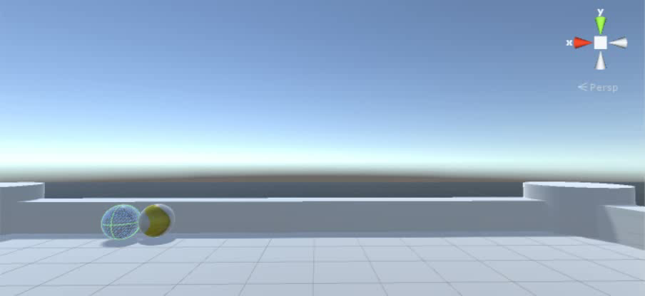
Application - Jump shot
Simulation
Notes:
And we also simulate the situation with direction-Z
With bounce
And here’s the video within a stroke.

Slide 16
Thank you for your attention
Reference
Strategic play for a pool-playing robot
T Nierhoff, K Heunisch, S Hirche - Advanced Robotics and its …, 2012 - ieeexplore.ieee.org
Object-oriented Simulation of Pool Ball Motion
AP Goldberg - 1987 - UCLA, Computer Science …
Realistic Billiards Simulation with Variable Time-Step
L Anderson

